Slide 1
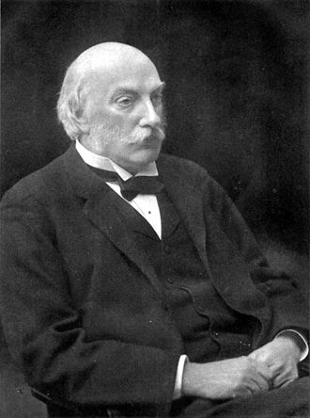
The Rayleigh Model
Left – Lord Rayleigh, pronounced like Riley. He was a famous physicist who, among other things, discovered Argon and explained why the sky was blue. And, it still is!
Kan Ch 7
Steve Chenoweth, RHIT
Notes:
Image from http://en.wikipedia.org/wiki/John_William_Strutt,_3rd_Baron_Rayleigh

Slide 2
It’s a Weibull distribution…
Used in physics:
It’s “Rayleigh” when m = 2.
Notes:
Kan p 189

Slide 3
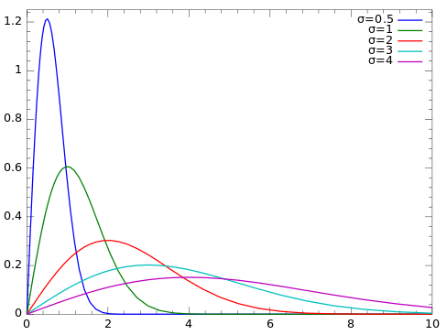
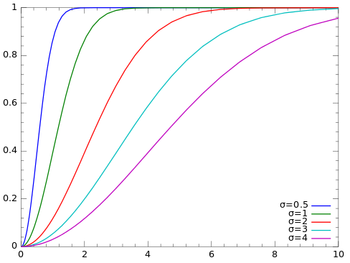
The Rayleigh Model is widely used
Lots of applications other than possibly the distribution of software bugs.
E.g., it’s what you get when two uncorrelated random variables combine.
Big batch of Weibulls
m = 2
Probability density function (PDF)
Cumulative distribution function (CDF)
Notes:
See http://en.wikipedia.org/wiki/Rayleigh_distribution

Slide 4
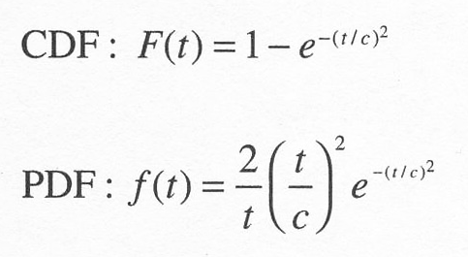
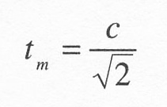
So, for Rayleigh…
We have this,
Where t = time and c = the “scale parameter,” and is a function of t_{m}, the time at which the curve reaches its peak. (Set the derivative of f(t) = 0 to get:
Notes:
Kan p 189

Slide 5
For software
Projects follow a life-cycle pattern described by the Rayleigh density curve.
Used for:
Staffing estimation over time
Defect removal pattern – expected latent defects
Notes:
Kan p 191

Slide 6
IBM AS/400
Notes:
Kan p 192

Slide 7
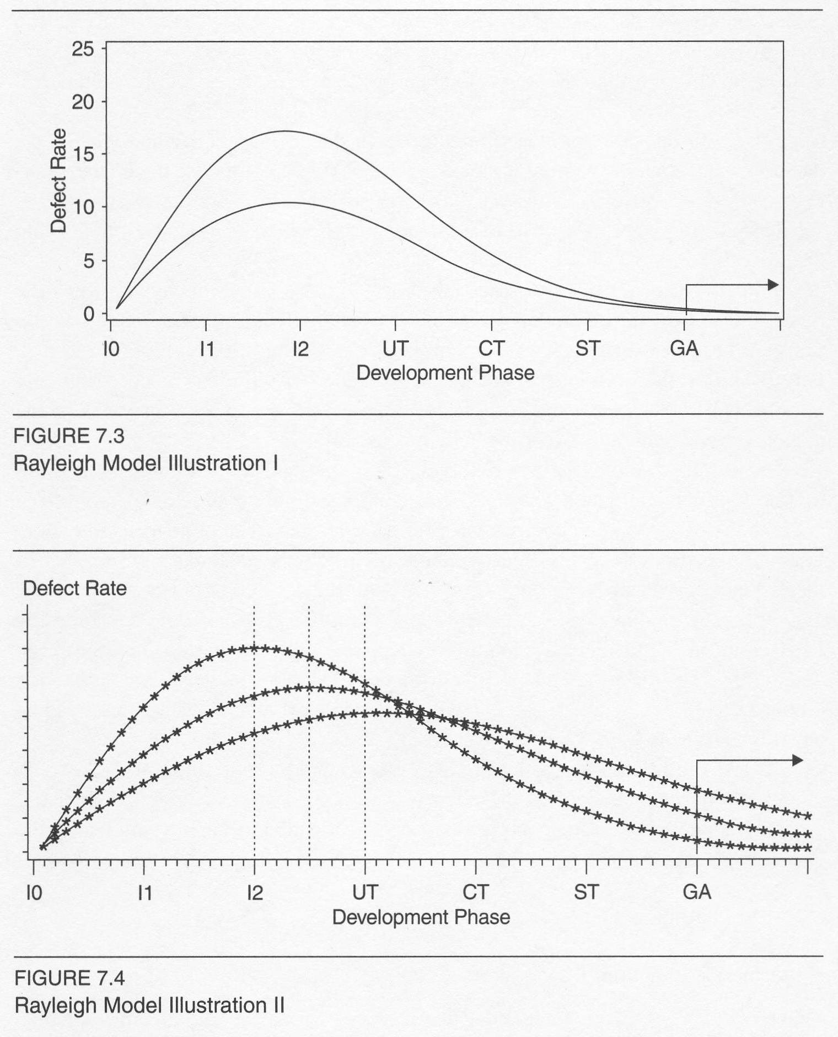
Assumes…
Defect removal effectiveness remains relatively unchanged. Then –
Higher defect rates in development are indicative of higher error injection, and
It is likely that the field defect rate will also be higher.
Given the same error injection rate, if more defects are discovered and removed earlier, fewer will remain in later stages. Then –
Field quality will be better.
Notes:
Kan pp 192-3

Slide 8
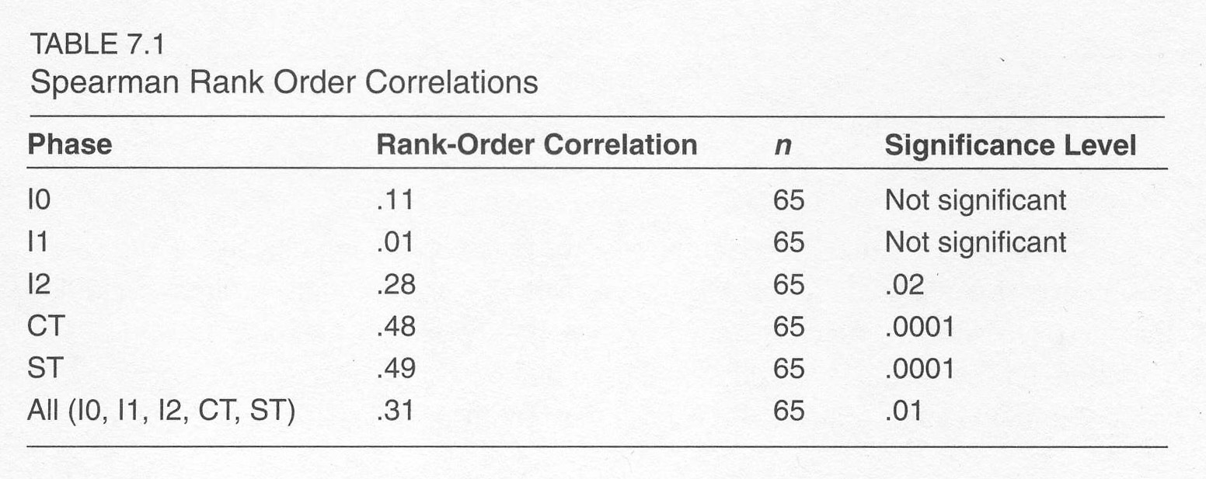
Kan studied this
A formal hypothesis-testing study, based on component data of the AS/400.
Strongly supported his first assumption.
Found proving the second assumption trickier.
Notes:
Kan pp 194-5

Slide 9
Implementation
Kan says it’s “not difficult.”
Adds elsewhere, “if you have an SAS expert handy.”
If defect data (counts or rates) are reliable,
Model parameters can be derived, then
Just substitute data values into the model.
Also built into software tools like SLIM (see p 200).
Notes:
Kan pp 195+

Slide 10
Kan’s example with STEER
Notes:
Kan p 202

Slide 11
Reliability
Can judge by testing “confidence interval.”
Which relates to sample size.
Kan recommends – use multiple models, to cross-check results.
Notes:
Kan p 203

Slide 12
Validity
Depends heavily on “data quality”
Which is notoriously low related to software
Usually better at back-end (testing)
And, “Model estimates and actual outcomes must be compared and empirical validity must be established.”
In our current state of the art, validity and reliability are “context specific.”
Notes:
Kan p 203

Slide 13
In Kan’s study…
Rayleigh underestimated the tail!
Notes:
Kan pp 204-5

